Slide 1

SCHOLARSHIP APP
Batch-4 Guide,
Ashritha.P Dr.K.Sangeetha
Madhumitha.P

Slide 2

ABSTRACT:
-> Scholarship Management System is software developed for managing various types of scholarships.
-> The proposed system has been designed to replace the existing manual system and user friendly.
-> It is used for managing the various scholarships in colleges.
-> It helps to find the details of eligible students and applied students.
-> In this various Universities/Colleges can add available scholarships and administrators can also add new scholarships update and delete the available scholarships.
-> Its very easy to handle than the existing system.

Slide 3

Existing System
→The scholarship webapps provide scholarship information about a particular university or a foundation and not the entire information.
→The already existing system is a webapp which lack information about students awareness of differences in college criteria are significant contributing factors leading to low rates of application.

Slide 4
Proposed System
India as we know is a densely populated country and every year more than 6 crores of Indians graduates from diverse backgrounds and with diversity in education.
Almost similar number of students enter into colleges for taking various education to help them in seeking jobs. With time students also look for good scholarships based on the merit, skills, income, etc. with growing technology and market scholarships in the market is also increasing but is the data is not confined to one place.
People have to find various places to check for good scholarships. Addressing this problem will help in knowing various national and international scholarships.
It will encourage students to increase their merit to get such scholarships for better future. We will develop a mobile app that shows the list of all national and international scholarships that gives values to the students.

Slide 5

LITERATURE
SURVEY

Slide 6

YEAR OF PUBLISHING | AUTHOR NAME | TITLE OF PAPER | MERITS & DEMERITS | EXPLANATION
2019 | GONZALES | AUTOMATED SCHOLARSHIP WEBAPP | They provide information that is scholarship office can give to scholars regarding the status alone. But they dont give information regarding the available scholarships and who are all eligible for the application. | They aim to develop a website of scholarship management with basic requirements, components and organise information of scholars of a university. The study utilises the design and development of the website since it focuses on the online application and detection of scholarship granted to the scholars.

Slide 7
YEAR OF PUBLISHING | AUTHOR NAME | TITLE OF PAPER | MERITS & DEMERITS | EXPLANATION
2015 | Wisconsin-La Crosse | Online Scholarship WebApp for their foundation | They tend to maintain only the particular foundation’s records. They maintain info of large number of scholars. | This System deals with a large number of Scholarship applications as the foundation uses paper-based processing.So,they automate the task performed by this foundation,they used re-engineering approach nmaed “EVOLUTIONARY ENGINEERING APPROACH”

Slide 8
YEAR OF PUBLISHING | AUTHOR NAME | TITLE OF PAPER | MERITS & DEMERITS | EXPLANATION
2013 | VILLANUEVA | SYSTEM FOR CBA SCHOLARSHIP | In this system the admins cannot add availabl scholarship information in the webapp. | The first phase made by the developer is to design and implement the database that would store all the data relevant to the system. In this there are two primary sets of data applicants and scholarships. In this system they can add, edit, delete and update information of each applicant. And the info are stored in database.

Slide 9
YEAR OF PUBLISHING | AUTHOR NAME | TITLE OF PAPER | MERITS & DEMERITS | EXPLANATION
2015 | LOPEZ | Scholarship web app | It also can be used for local assessment of college of nursing fortheir college fees. The database is organised to produce query about student name progran and year. | Developed a system that aimed to form a system that stores the details of students their courses and year. The database is designed to be used by staff and other authorised user in the college to enable them to easily produce information required by users.

Slide 10

DEVELOPMENT ENVIRONMENT
Hardware Requirements:
→System
→4GB RAM
→100 GB Memory space

Slide 11
DEVELOPMENT ENVIRONMENT
Software Requirements:
→Framework used - Flutter
→Coding language - Dart
→Operating system - Windows xp, Linux, Mac os

Slide 12


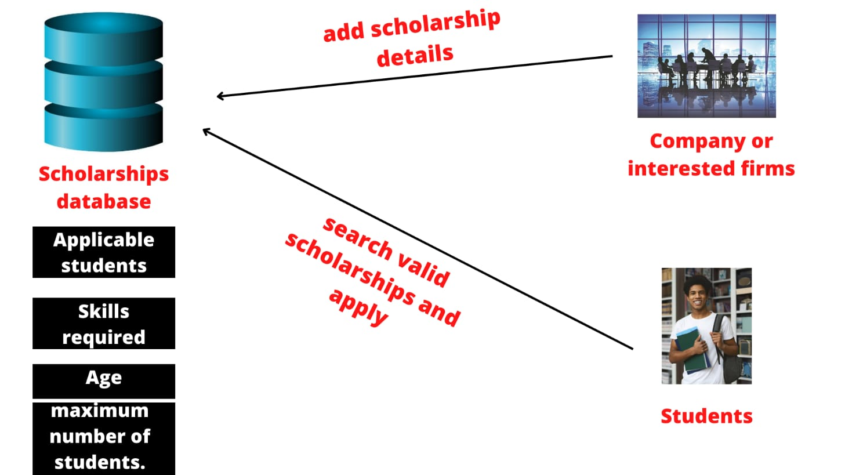
SYSTEM ARCHITECTURE

Slide 13
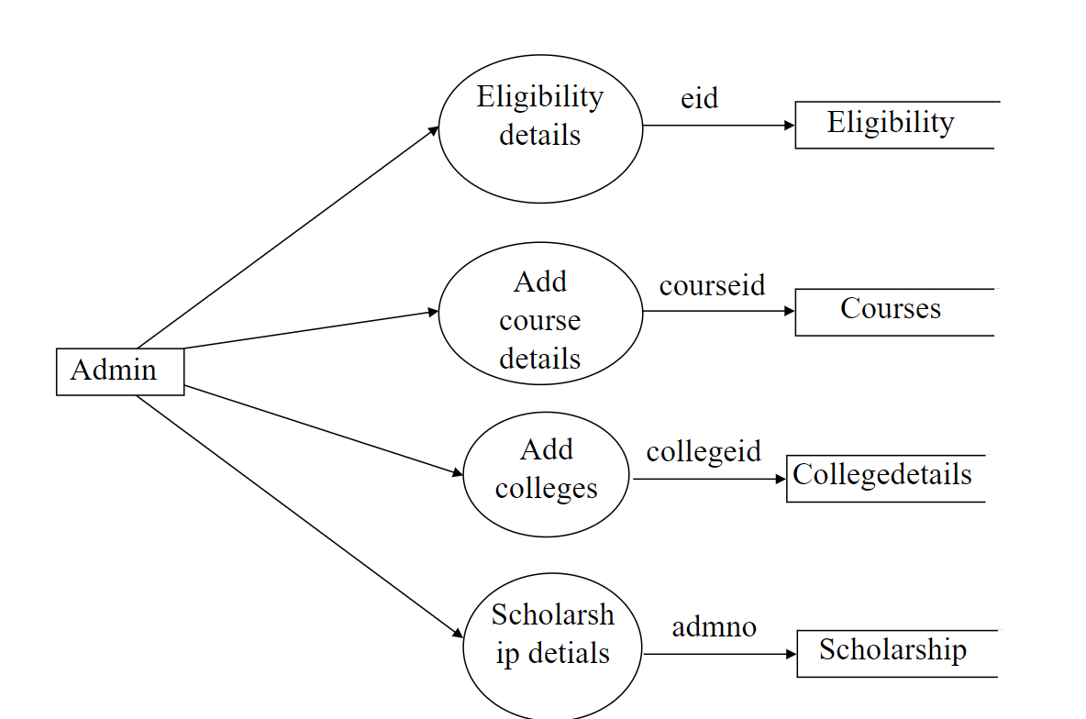
SYSTEM ARCHITECTURE

Slide 14
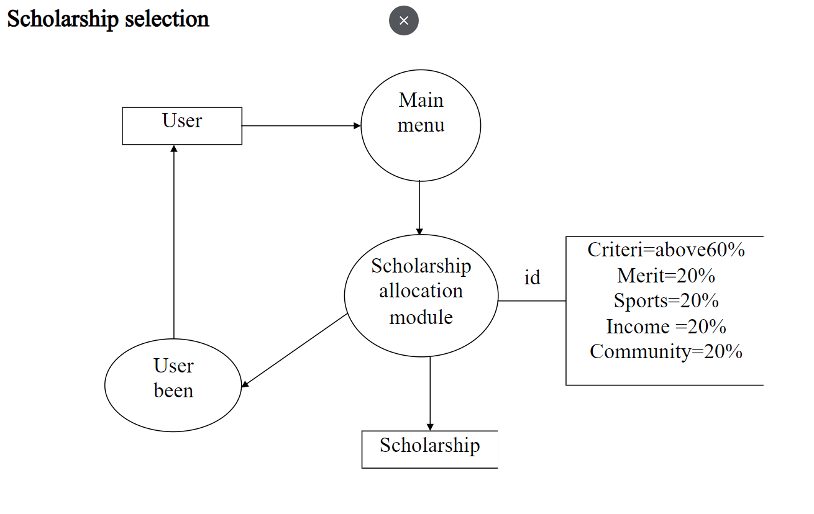
SYSTEM ARCHITECTURE

Slide 15
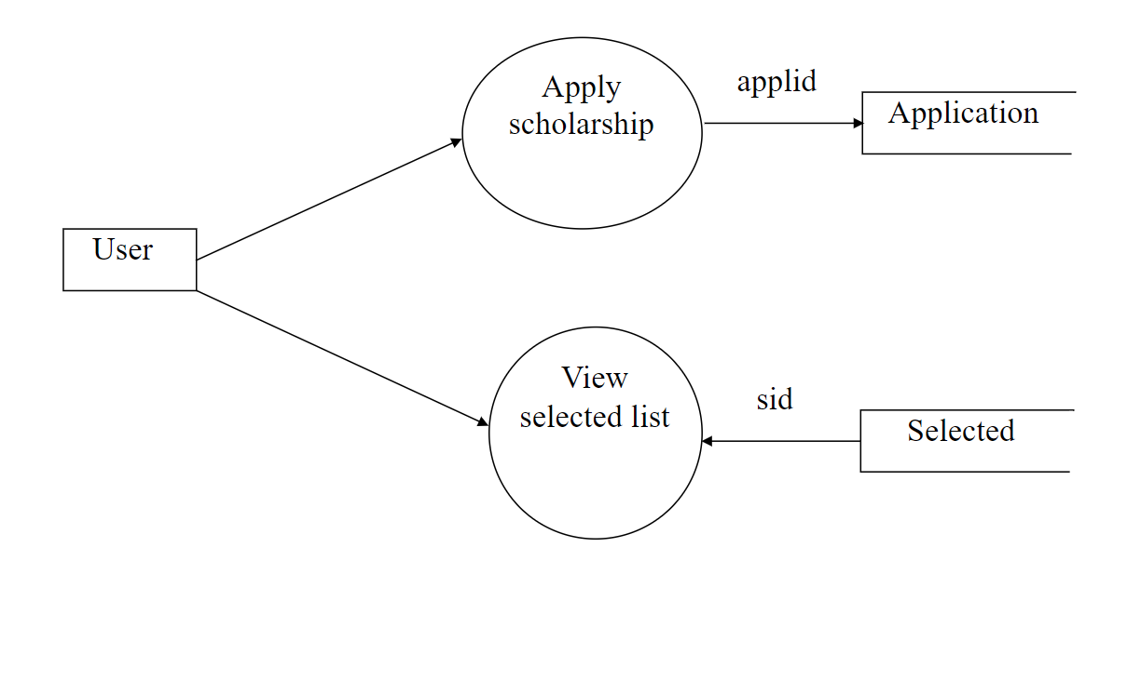
SYSTEM ARCHITECTURE

Slide 16

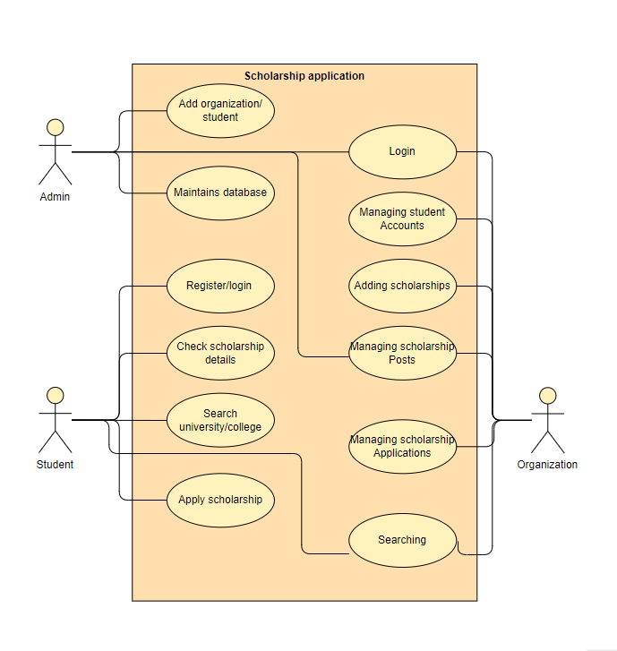
USE CASE DIAGRAM

Slide 17
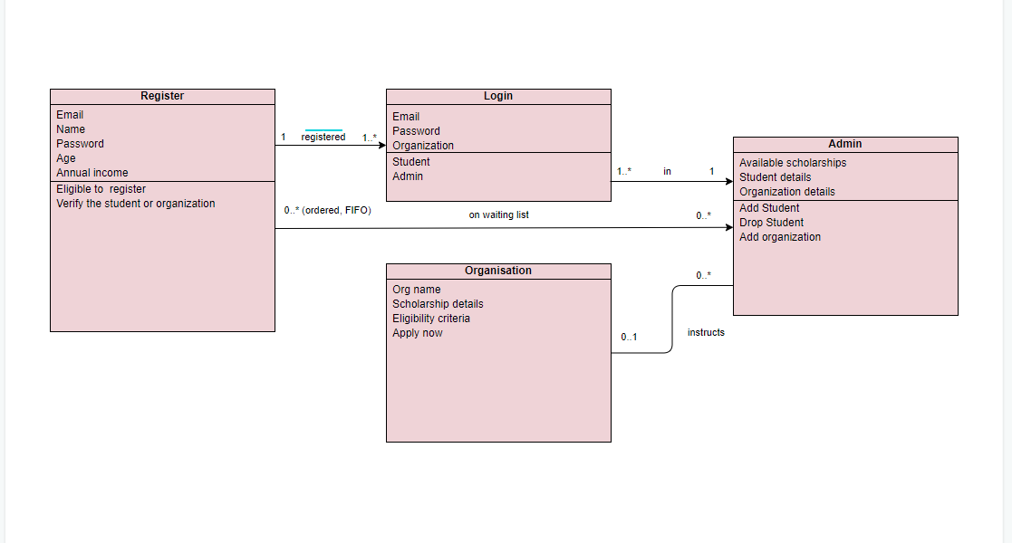
CLASS DIAGRAM

Slide 18
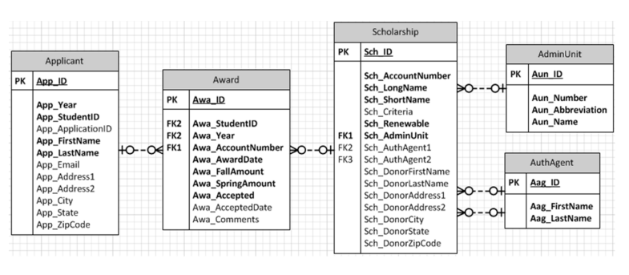
ER DIAGRAM

Slide 19
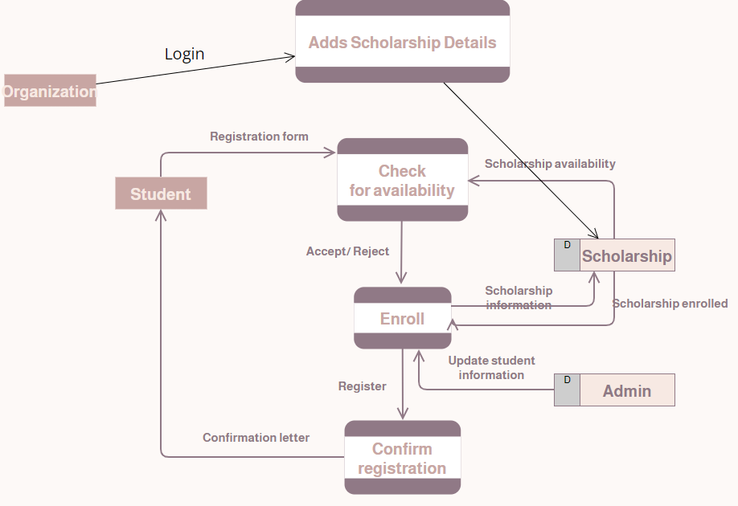
DATA FLOW DIAGRAM

Slide 20
MODULES
→ Registration form
→ Login
→ Admin Organisation Student
→ Scholarship details

Slide 21

MODULES
First as you open the app the register page will appear. If you are a new user you have to register else you have to login. And then in login page you will have three login sections to check whether you are admin, organisation or student. If you are a student you will be displayed a list of available scholarships of various universities or foundations. You can apply according to the incomes and mark. If its an admin you can add organisations/students which can add the. If the organisation can add scholarships. And the registered informations are stored in the firebase database from which we can get the information about students.

Slide 22
SCREENSHOTS

Slide 23
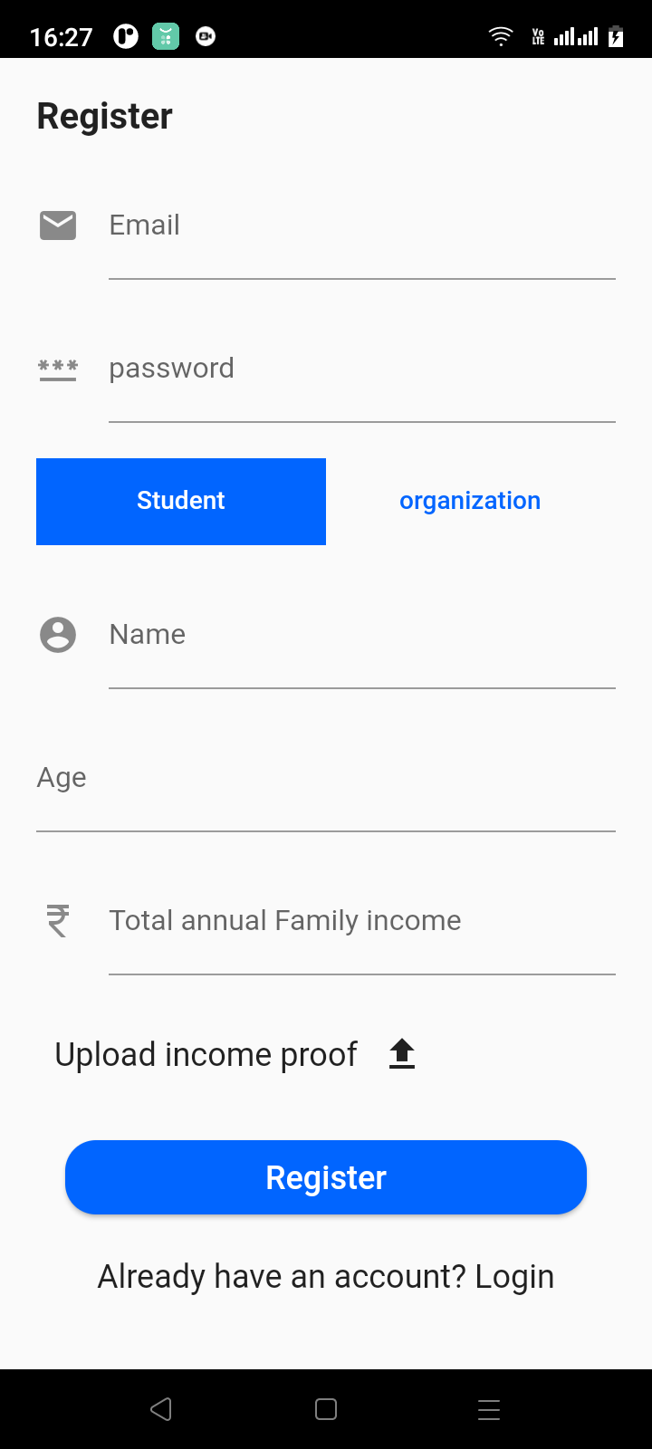
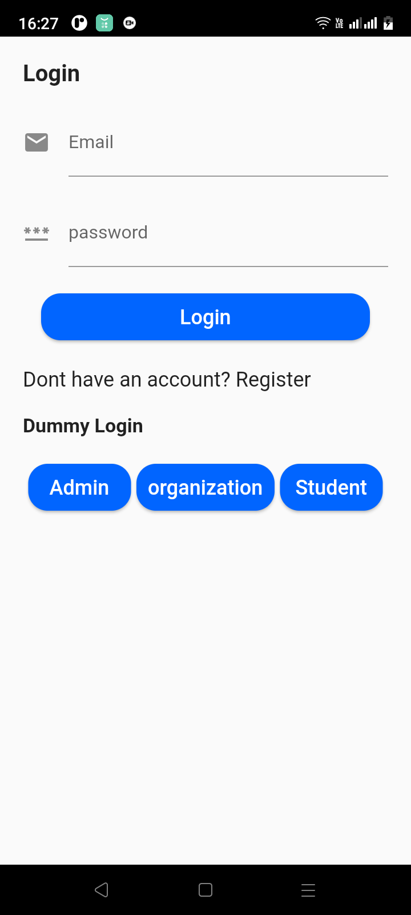

Slide 24
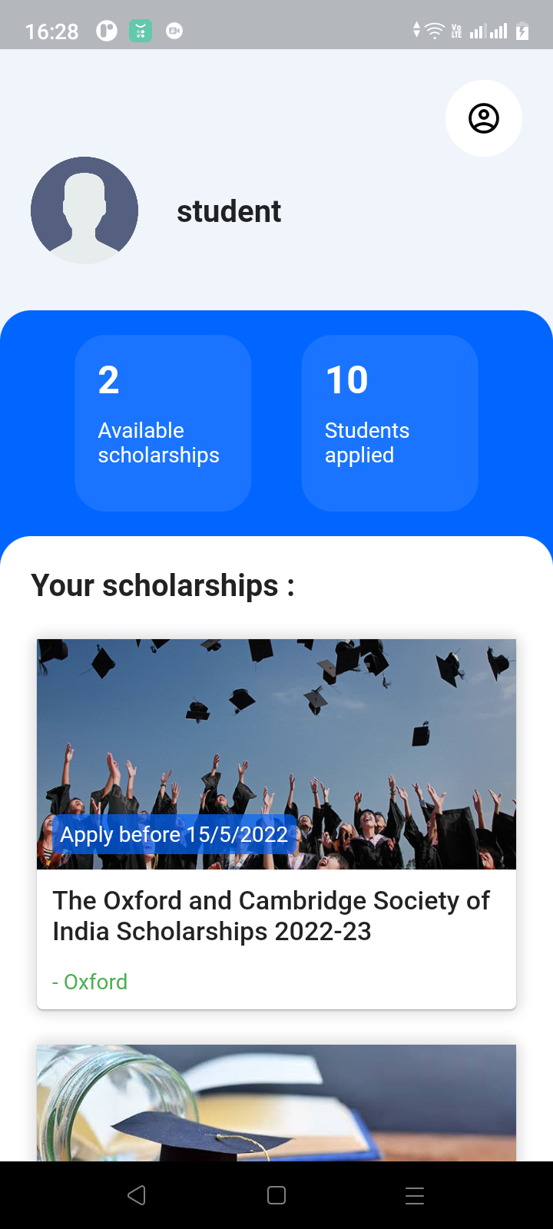
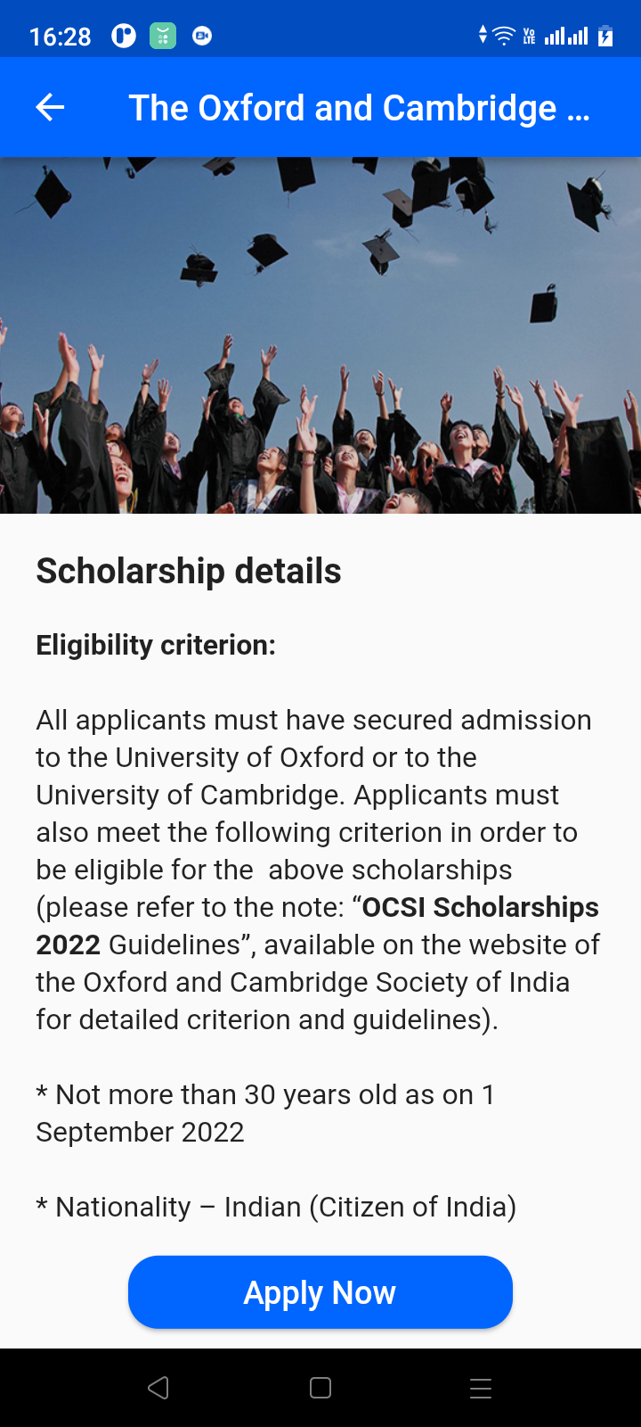

Slide 25

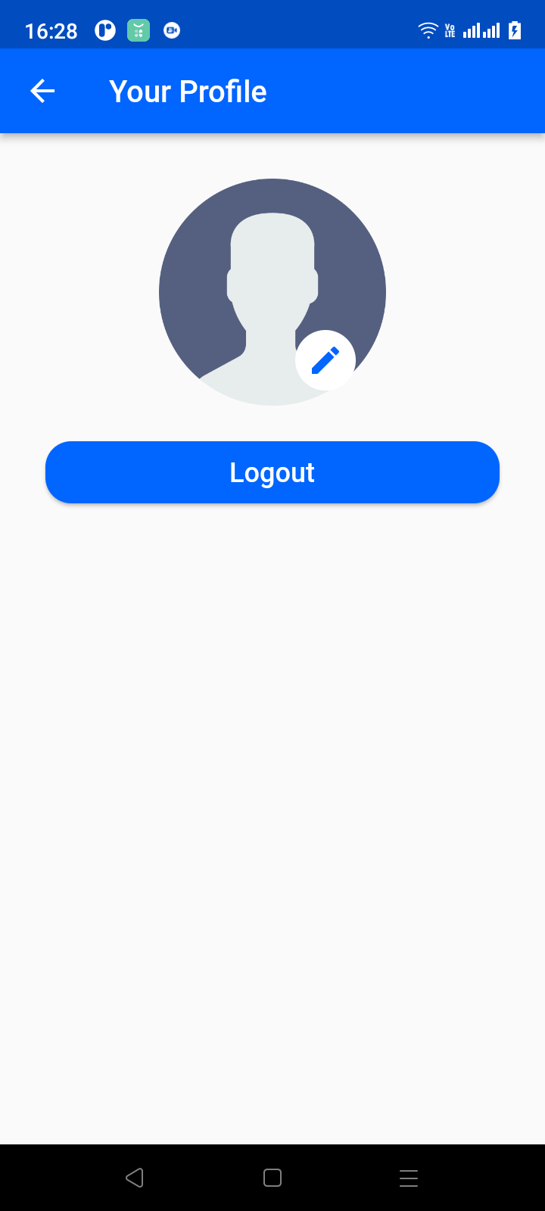
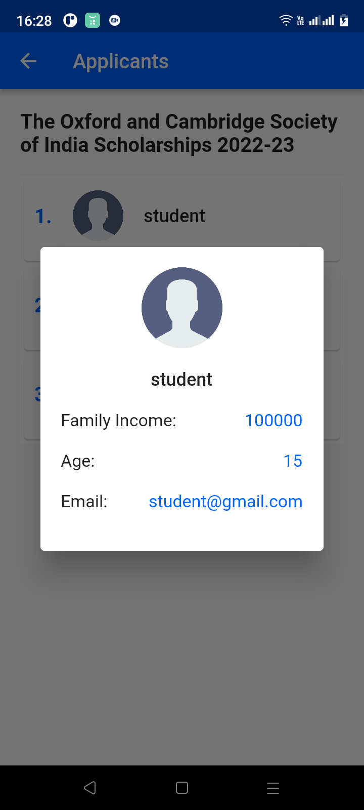

Slide 26

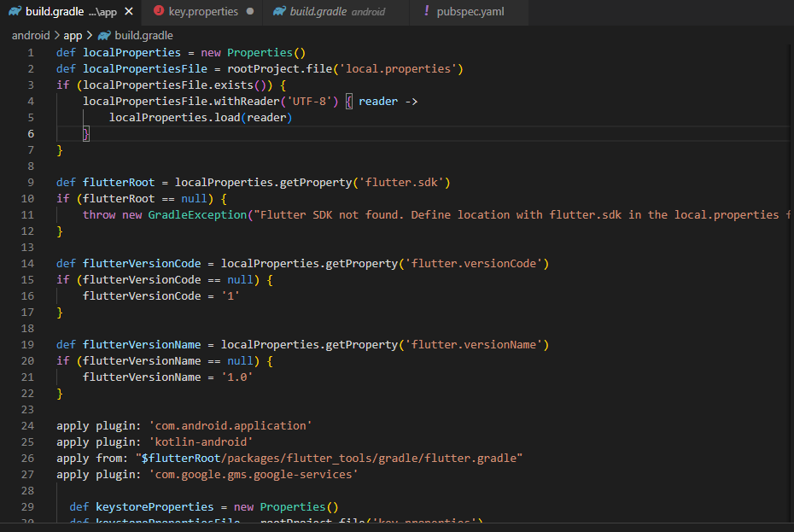

Slide 27
CONCLUSIONS
→ In this work, The online web-based application allowed students to apply for scholarship online irrespective of their geographical locations and also provide them with feedback services.
→ The app was developed using Flutter and Firebase. It is hoped that effective implementation of this software product would eliminate many problems discovered during system’s investigation. We therefore make the following recommendations. Individuals, foundations and private organizations that award scholarships to students and to automate their various scholarship application processes.
→ So that the workload associated with the manual system can be reduced considerably.It connects the organization and students who are in need to apply scholarship.
→ Using this app its easy for anyone to apply and view scholarship details.

